Slide 1

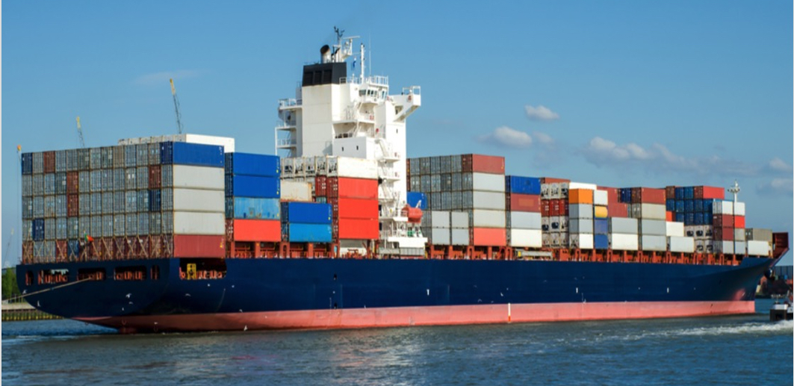
Containers 101 for Beginners
Kubernetes Community Days Chennai 21 May 2022

Slide 2

Speaker Intro
Naveen Raman
Senior Software Engineer, Ericsson Global Services Limited
ML Ops Design Development
Organizer: Kubernetes Community Days Chennai
Twitter: @naveenraman
Website: http://naveenraman.net/
LinkedIn: https://www.linkedin.com/in/naveenraman/

Slide 3

Speaker Intro
Kannan V
Senior Technical Lead, Tata Communications Ltd
Designing and Developing the Private Cloud
Organizer: Kubernetes Community Days Chennai
Tech blogger: dev.to/kannanvr
Twitter: @kannanvanniaraj
LinkedIn: linkedin.com/in/kannan-vanniarajan-07405771

Slide 4

About KCD Chennai 2022
A community-organized online conference supported by the Cloud Native Computing Foundation (CNCF). It gathers adopters, technologists and students from open source and cloud-native communities for education, collaboration and networking.
When: 3-4 June 2022
3 Tracks: Developer, DevOps, Beginners
4 Keynotes, 28 Breakout sessions, 2 Workshops
Quiz, Fun games, Prizes
T-Shirt swag to all attendees
RSVP: kcdchennai.in

Slide 5
Agenda
Introduction
Overview of containers
Container architecture
Containers vs Virtual Machines
Docker Containers
Introduction to Docker
Docker Concepts
Running “Hello World” application using Docker
Docker images and layering
Managing docker containers
Deep Dive
What is a Docker file
Docker commands
Namespaces and Control Groups
Basics on Docker volumes
Overview of Docker networking
Live Lab: Build and launch Python “Hello World” application in a container

Slide 6
What is a Container?
A container is a standard unit of software that packages up code and all its dependencies, so the application runs quickly and reliably from one computing environment to another.
Container
Application
Bins/Libs

Slide 7
Container Architecture
Container
Container
Salient Features
Self contained applications
Operational Isolation
Share Host Operating System
Target Hardware and OS agnostic
Resource isolation and guarantees
App A
App B
Bins/Libs
Bins/Libs
Container Runtime
Host Operating System
Hardware

Slide 8
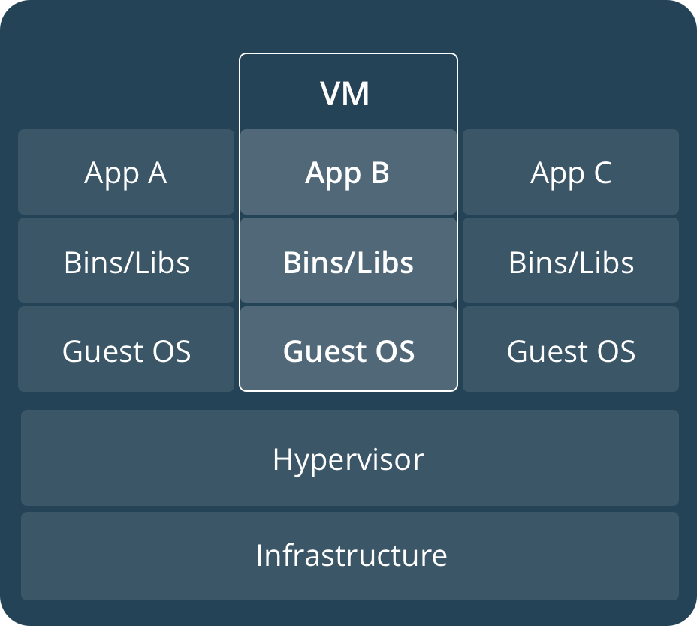
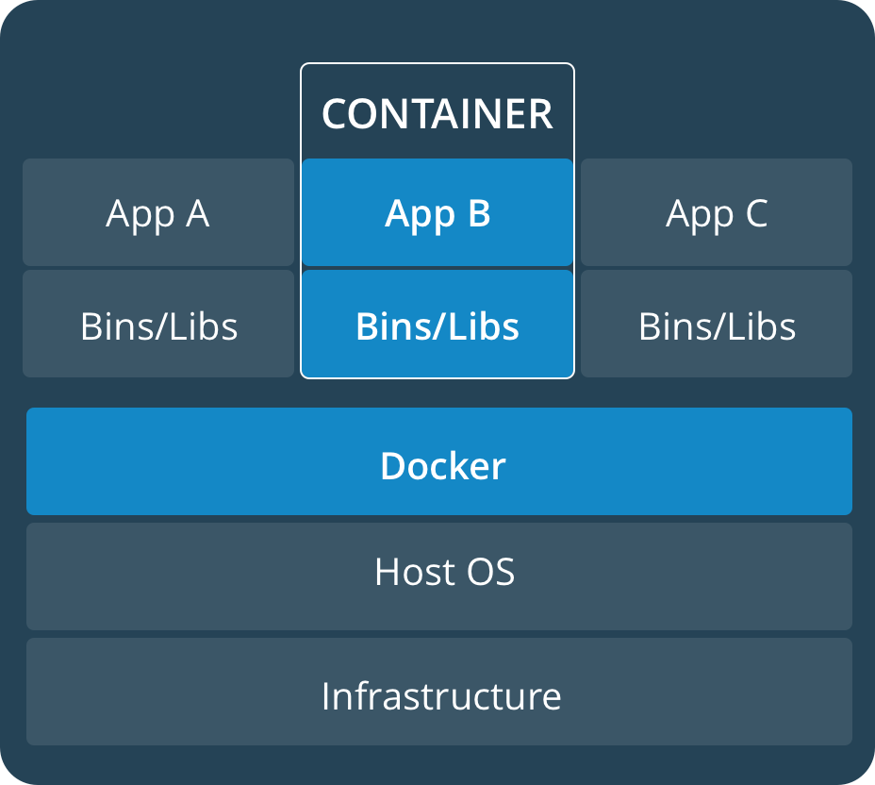
Container vs Virtual Machines
Virtual Machine
Container
Container ≠ VM
Resource Intensive
Strong security boundary
Can Use different OS
Slow start
Lightweight
Simple Isolation and less secure
Shares same OS
Rapid bootup
Source: docs.docker.com

Slide 9
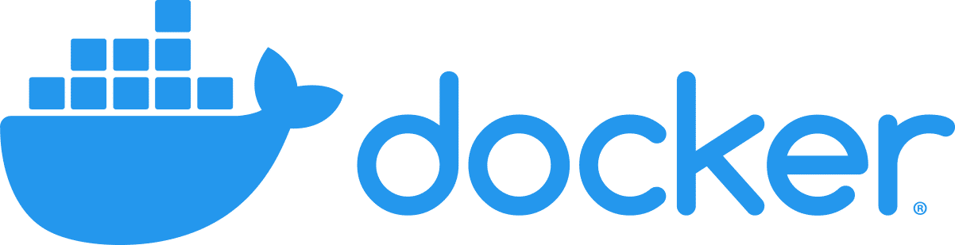
Docker Containers
Docker is an open platform for developing, shipping, and running applications. Docker enables you to separate your applications from your infrastructure so you can deliver software quickly. With Docker, you can manage your infrastructure in the same ways you manage your applications. By taking advantage of Docker’s methodologies for shipping, testing, and deploying code quickly, you can significantly reduce the delay between writing code and running it in production.

Slide 10

Docker Concepts
Docker registries
A Docker registry stores Docker images. Docker Hub is a public registry that anyone can use, and Docker is configured to look for images on Docker Hub by default. You can even run your own private registry.
The Docker daemon
The Docker daemon (dockerd) listens for Docker API requests and manages Docker objects such as images, containers, networks, and volumes. A daemon can also communicate with other daemons to manage Docker services.
Docker objects
Images
An image is a read-only template with instructions for creating a Docker container. Often, an image is based on another image, with some additional customization.
Containers
A container is a runnable instance of an image. A container is defined by its image as well as any configuration options you provide to it when you create or start it.
The Docker client
The Docker client (docker) is the primary way that many Docker users interact with Docker. When you use commands such as docker run, the client sends these commands to dockerd, which carries them out. The docker command uses the Docker API. The Docker client can communicate with more than one daemon

Slide 11

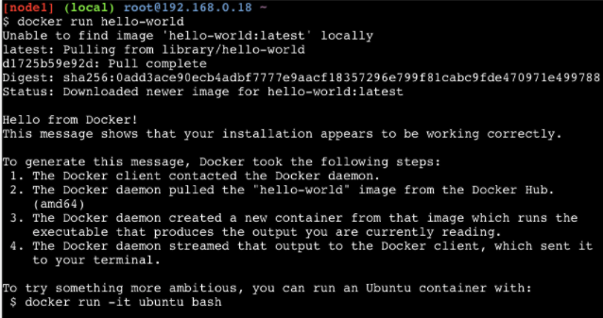
Hello World App
Running a hello world application in docker is as simple as typing below command -
So, what’s happened here?
We’ve called the docker run(Docker Client) command, which is responsible for launching containers.
The argument hello-world is the name of the image that was created on dockerhub.
Docker command will first search for "hello-world" image locally. If image is not found locally, then it will search in Dockerhub registry.
Once the image is found. It will be downloaded,
Docker turns the image into a running container and executes it.

Slide 12
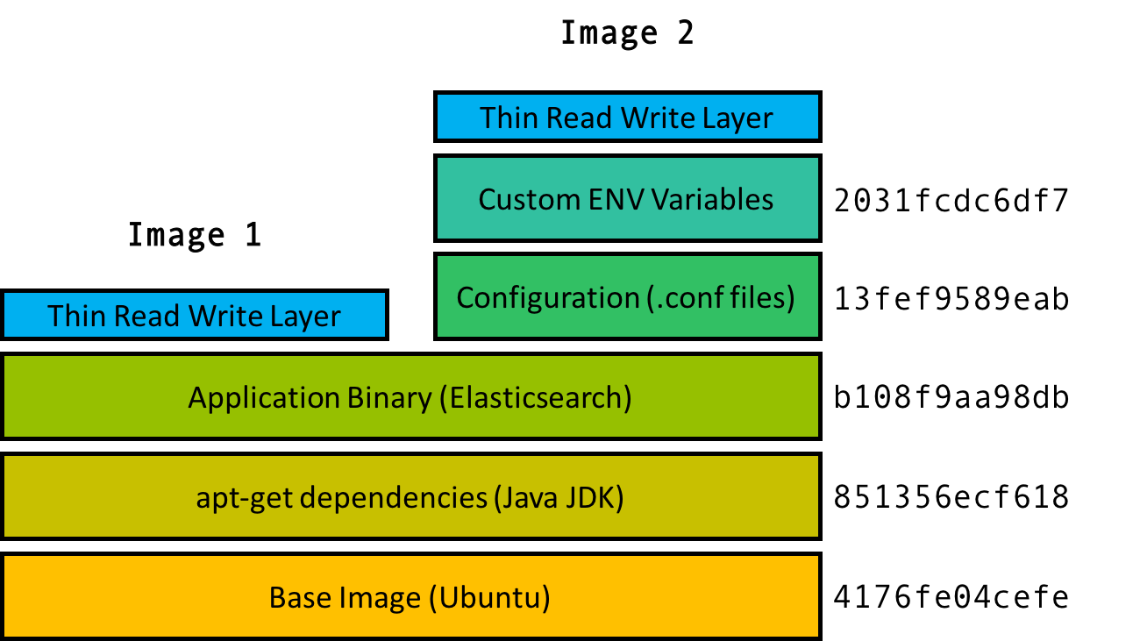
Image Layering
Docker container is made up of layer of images, binaries packed together into a single package
Layer is a delta of filesystem snapshot from base image
Each layer is built on top a base layer
Every container has an OS image layer which consists of OS file system and binaries.
OS layer does not include the OS kernel
Each layer is hashed with a unique identity.
Containers using same base layer share the copy of the layer
Layer with same hashes are not duplicated
Image 1 and Image 2 share bottom three layers of filesystem

Slide 13
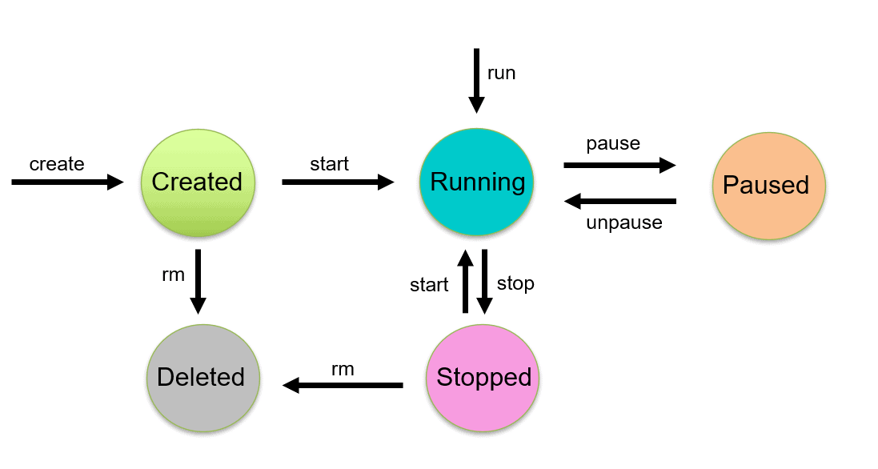
Managing Docker Containers
Container lifecycle
Docker containers have various stages in its lifecycle
Managing docker container is the task of orchestrating this lifecycle
Orchestration of docker containers can be done either manually or automatically
Manually managing docker containers involves running docker commands to invoke docker daemon via CLI
There are several platforms that can automatically orchestrate life cycle of docker containers
Some examples of container orchestrators are Kubernetes, docker swarm and openshift
Controlling docker containers automatically is not within the scope of this workshop
Docker CLI provides all commands to manage lifecycle of docker containers such as creation, inspection, listing containers, running them, as well as removal

Slide 14

Docker Containers – Deep Dive

Slide 15
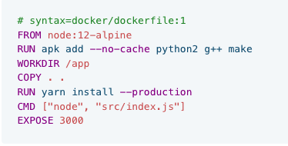
Docker File
What is a Dockerfile?
A Dockerfile is a text file which contains a series of commands or instructions.
These instructions are executed in the order in which they are written.
Execution of these instructions takes place on a base image.
On building the Dockerfile, the successive actions form a new image from the base parent image.
Dockerfile shown on right contains a set of instructions on building and running a node js application and receive traffic on port 3000
All dependencies required to run the application are installed/copied as steps in the dockerfile
A container image can then be built using this file

Slide 16
Docker Commands
Docker commands are keyword used to build instructions inside a dockerfile. These keywords give capabilities such as copying external packages or running a command
Commands
COPY – The COPY instruction copies files or directories from source and adds them to the filesystem of the container at destination
ADD – Similar to COPY. But support other sources such as URL
CMD – This keyword is used to specify defaults for an executing container. They can also be used to provide arguments to ENTRYPOINT
ENTRYPOINT – An ENTRYPOINT allows you to configure a container that will run as an executable
WORKDIR – The WORKDIR instruction sets the working directory for any RUN, CMD, ENTRYPOINT, COPY and ADD instructions that follow it in the Dockerfile
RUN – The RUN instruction will execute any commands in a new layer on top of the current image and commit the results. The resulting committed image will be used for the next step in the Dockerfile

Slide 17
Docker Commands - Contd
Commands
ARG – The ARG instruction defines a variable that users can pass at build-time to the builder with the docker build command
ENV - The ENV instruction sets the environment variable <key> to the value <value>. This value will be in the environment for all subsequent instructions in the build stage
EXPOSE – The EXPOSE instruction informs Docker that the container listens on the specified network ports at runtime. You can specify whether the port listens on TCP or UDP, and the default is TCP if the protocol is not specified
VOLUME – The VOLUME instruction creates a mount point with the specified name and marks it as holding externally mounted volumes from native host or other containers
LABEL – The LABEL instruction adds metadata to an image. A LABEL is a key-value pair
ONBUILD – The ONBUILD instruction adds to the image a trigger instruction to be executed later, when the image is used as the base for another build
HEALTHCHECK - The HEALTHCHECK instruction tells Docker how to test a container to check that it is still working

Slide 18
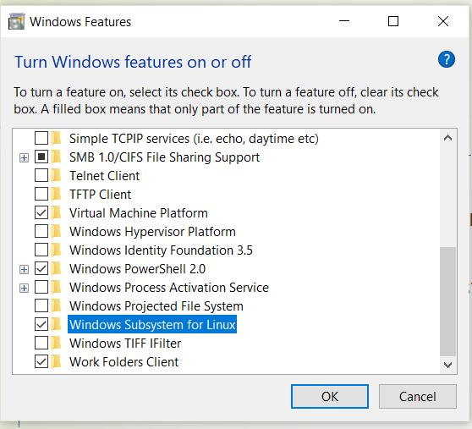
Installing Docker on Windows
Enable WSL on windows -10
Open “Turn Windows Feature On or Off” option from your search bar on windows machine
Enable the option “Windows Subsystem For Linux” and restart the windows PC

Slide 19
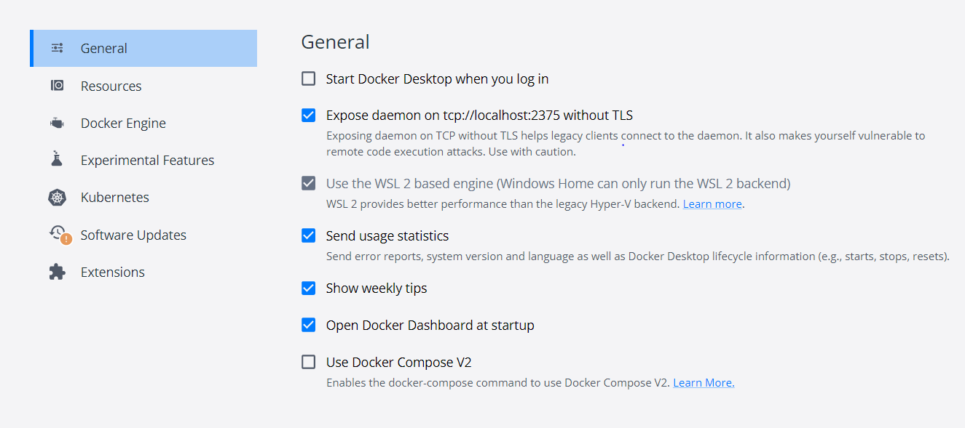
Install docker Desktop
Download the docker binary from below link
Install the docker desktop from downloaded binary
Open docker desktop and choose the setting option and enable the option “Expose daemon on tcp://localhost:2375 without TLS”

Slide 20
Install git and clone the project
Click on the below URL to download the git
https://git-scm.com/download/win
Download the git based on the architecture of your machine
Install git software on windows
Clone the Project
git clone https://github.com/kcdchennai/kcdworkshops.git
change the directory of kcdworkshops
cd kcdworkshops

Slide 21
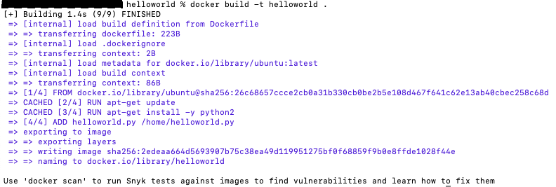
Container Lab

Slide 22
Namespaces
Namespaces are a feature of the Linux kernel that partitions kernel resources such that one set of processes sees one set of resources while another set of processes sees a different set of resources. For containers namespaces provide needed isolation to separate workloads from each other
Types of Namespaces
A user namespace has its own set of user IDs and group IDs for assignment to processes. In particular, this means that a process can have root privilege within its user namespace without having it in other user namespaces.
A process ID (PID) namespace assigns a set of PIDs to processes that are independent from the set of PIDs in other namespaces. The first process created in a new namespace has PID 1 and child processes are assigned subsequent PIDs.
A network namespace has an independent network stack: its own private routing table, set of IP addresses, socket listing, connection tracking table, firewall, and other network‑related resources.
A mount namespace has an independent list of mount points seen by the processes in the namespace. This means that you can mount and unmount filesystems in a mount namespace without affecting the host filesystem.
An interprocess communication (IPC) namespace has its own IPC resources, for example POSIX message queues.
A UNIX Time‑Sharing (UTS) namespace allows a single system to appear to have different host and domain names to different processes.

Slide 23
Control Groups(cgroups)
A control group (cgroup) is a Linux kernel feature that limits, accounts for, and isolates the resource usage (CPU, memory, disk I/O, network, and so on) of a collection of processes. Namespaces are a feature of the
Features
Resource limits – You can configure a cgroup to limit how much of a particular resource (memory or CPU, for example) a process can use.
Prioritization – You can control how much of a resource (CPU, disk, or network) a process can use compared to processes in another cgroup when there is resource contention.
Accounting – Resource limits are monitored and reported at the cgroup level.
Control – You can change the status (frozen, stopped, or restarted) of all processes in a cgroup with a single command.
Cgroups are a key component of containers because there are often multiple processes running in a container that you need to control together. In a Kubernetes environment, cgroups can be used to implement resource requests and limits and corresponding QoS classes at the pod level.

Slide 24
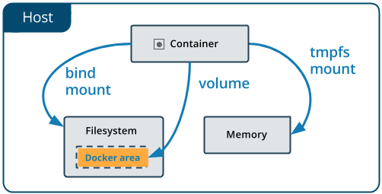
Docker Volumes
Containers run applications in an isolated environment.
By default, all the changes inside the container are lost when the container stops.
If we want to keep data between runs, Docker volumes and bind mounts can help
Volumes are the preferred mechanism for persisting data generated by and used by Docker containers.
Advantages
Volumes are easier to back up or migrate than bind mounts.
You can manage volumes using Docker CLI commands or the Docker API.
Volumes work on both Linux and Windows containers.
Volumes can be more safely shared among multiple containers.
Volume drivers let you store volumes on remote hosts or cloud providers, to encrypt the contents of volumes, or to add other functionality.
New volumes can have their content pre-populated by a container.
Volumes on Docker Desktop have much higher performance than bind mounts from Mac and Windows hosts.

Slide 25
Docker Volumes - Contd
Bind Mounts vs Docker Volumes
Bind Mounts
A Docker bind mount is a high-performance connection from the container to a directory on the host machine. It allows the host to share its own file system with the container, which can be made read-only or read-write.
This allows us to use a container to run tools that we don't want to install on our host, and yet still work with our host's files
Docker Volumes
A bind mount uses the host file system, but Docker volumes are native to Docker.
The data is kept somewhere on storage attached to the host – often the local filesystem.
The volume itself has a lifecycle that's longer than the container's, allowing it to persist until no longer needed.
Volumes can be shared between containers
Types –
Host Volumes
Anonymous Volumes
Named Volumes

Slide 26
Docker Networking
Containers run as isolated environments. If so, how do they communicate with outside world? And with each other? Answer is using docker networking concepts. Docker support wide variety of network types.
Docker supported network types
Docker default networking(docker0) - When Docker is installed, a default bridge network named docker0 is created. Each new Docker container is automatically attached to this network, unless a custom network is specified. Besides docker0 , two other networks get created automatically by Docker. Host and none networks.
Other network types
Bridge Networks - Bridge networking is the most common network type. It is limited to containers within a single host running the Docker engine
Overlay Networks - An overlay network uses software virtualization to create additional layers of network abstraction running on top of a physical network. In Docker, an overlay network driver is used for multi-host network communication
Macvlan Networks - Macvlan driver is used to connect Docker containers directly to the host network interfaces through layer 2 segmentation. No use of port mapping or network address translation (NAT) is needed and containers can be assigned a public IP address which is accessible from the outside world

Slide 27
Docker Networking - Contd
Bridge
Bridge network is provided by default in docker
Running command “docker network ls” should display all available networks
Docker run command used to start a container will implicitly add net=bridge during runtime
This will allow container to communicate with other docker containers
Additionally, users can get more control by creating user-defined bridge using command “docker network create”
Macvlan
Macvlan networks are best for legacy applications
They are best suited for applications that need physical network to be attached
Macvlan network allow you to assign a MAC address to container thereby making it appear as physical device
Overlay
Overlay networking is used when there is a need to setup distributed virtual network
This network sits on top of (overlays) the host-specific networks, allowing containers connected to it to communicate securely when encryption is enabled
Docker transparently handles routing of each packet to and from the correct Docker daemon host and the correct destination container

Slide 28
Thank you

